Slide 1
Midterm Review

Slide 2
Outline
Variables
Array of objects
Class and objects
Inheritance
Abstraction
Polymorphism
Generic class & sorting
Try-Catch-Finally and exceptions

Slide 3
Variables
Shared among all instances, declared using static.
Instance variables – Non-static, defined inside a class but outside methods, each object has its own copy.
Local variables – Variables declared inside methods or blocks, only accessible within them.
Static variables - Shared among all class instances, declared using static.
Final
Used to create constants (variables cannot be reassigned).
final methods cannot be overridden.
final classes cannot be subclassed.

Slide 4
Scope
Local variable is visible within the block it is declared & inner blocks
In Java, inner block cannot declare var of the same name

Slide 5
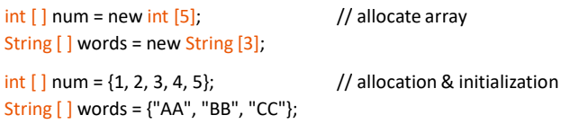
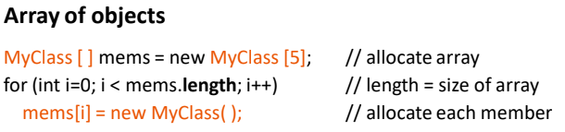
Array
Array in Java is treated as an object. It is allocated in heap. Each array’s element is assigned initial value automatically.

Slide 6
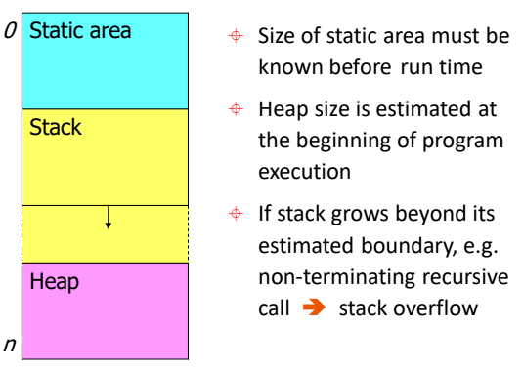
Memory Management
Static memory
Store values whose memory requirements are known at compile time & remain constant throughout program execution, e.g. global and static variables
Allocated when the class is loaded only once
Run-time stack
Used for passing execution control between active functions
Store parameter-argument linkage and local variables
Heap
Store values allocated at run time
Dynamic allocation / de-allocation causes fragmented heap, so garbage collection is needed to manage available space

Slide 7
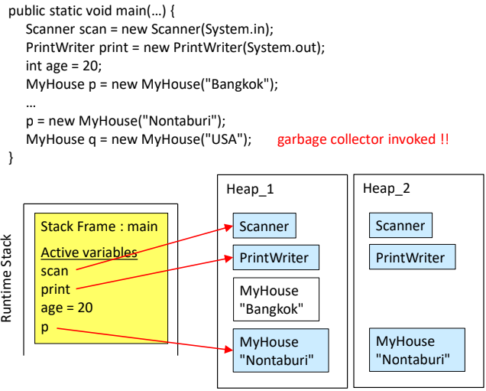
Memory Management

Slide 8
Class
Class = type declaration which encapsulates:
Member variables
Member functions or methods
Constructors (no destructor in Java)
There may be inner-classes within a class

Slide 9
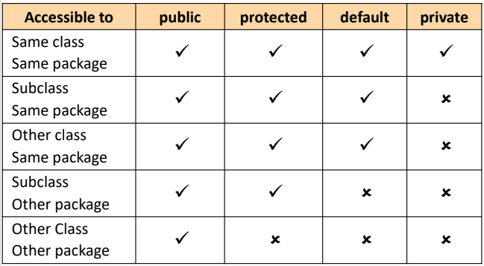
Visibility Rules

Slide 10
Lifetime
Class
When program execution starts, class with main method is loaded into code segment memory (no object creation)
If there are references to other classes, they will be loaded into the memory
All loaded classes remain in the memory until the program terminates
Object
Lifetime starts when object is allocated on heap and its address is held by reference variable
Automatic de-allocation, when no reference to object E.g. reference var is assigned a new address; exit from current execution block

Slide 11
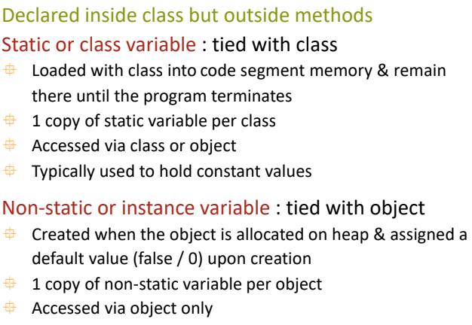
Member Variables

Slide 12
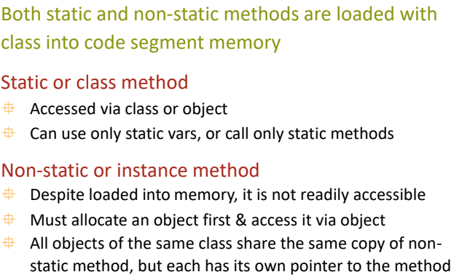
Member Methods

Slide 13
Method Overloading
Implement similar tasks using the same method name
Overloaded methods are distinguished by their parameters
But they cannot be distinguished by return type
For example, overloading
int action(String x) AND int action(String x, int y) - Correct
int action(String x) AND void action(String x) - Incorrect

Slide 14
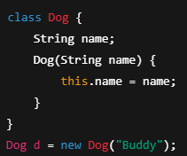
Constructor
A constructor is a special method used to initialize objects when they are created.
Has the same name as the class.
No return type, not even void.
Called automatically when you use new.
The constructor must be accessible by the method that calls it (not private).

Slide 15
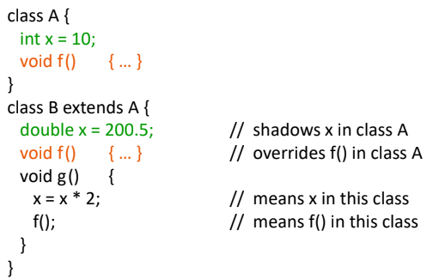
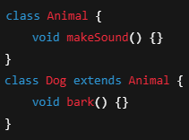
Inheritance
Uses the keyword extends
Allows a class to inherit variables and methods from another.
Child class cannot access private methods and variables of the parent.
Methods from the parent can be overridden in the child class.

Slide 16
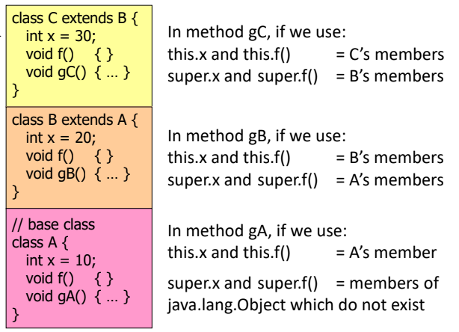
Reference
this : access members in the current class -> this.var, this.method()
super : access members in superclass that are shadowed or overridden -> super.var, super.method()

Slide 17
Abstraction
Abstract class
Base class for shared code/behavior
Can have abstract and concrete method -> child class must override abstract methods
A class can extends only one abstract class
Interface
Contains the list of variables and methods to be included.
Methods do not have implementation detail (are abstract)
A class can implements many interfaces

Slide 18
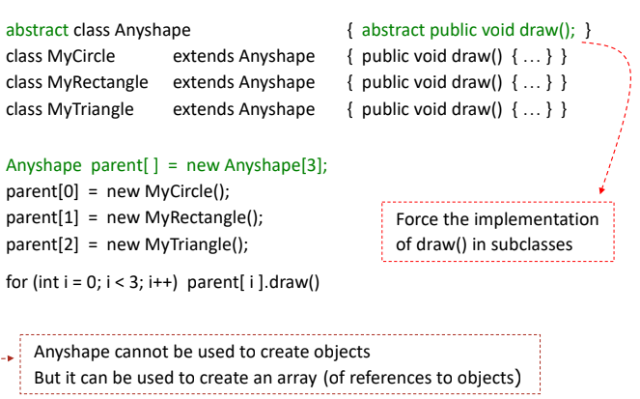
Abstract Class and Polymorphism

Slide 19
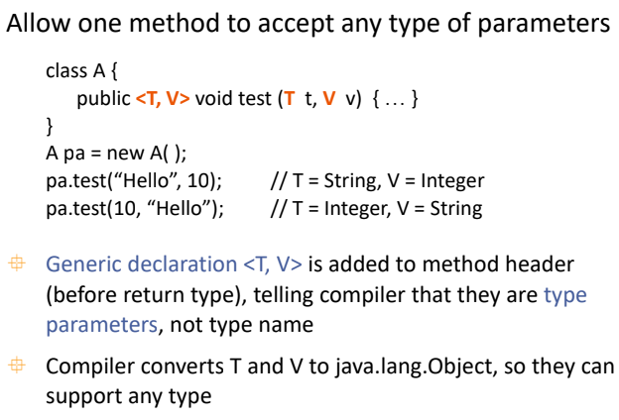
Generic Method

Slide 20
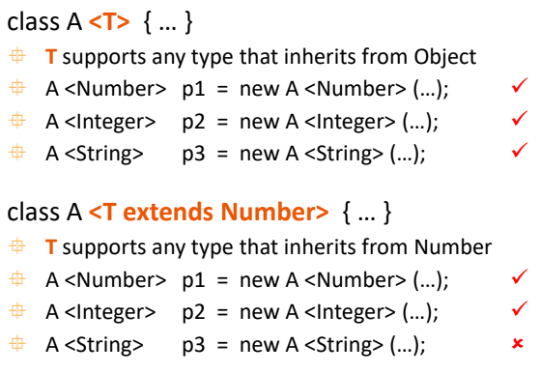
Generic Method

Slide 21
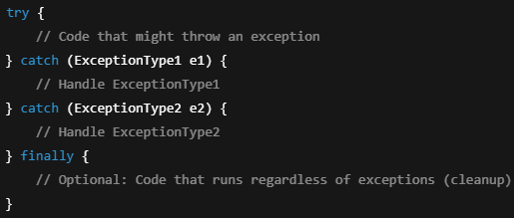
Try-Catch-Finally
Used to capture errors and handle them with the program crashing
Finally is optional and will always run, even if return happens.

Slide 22
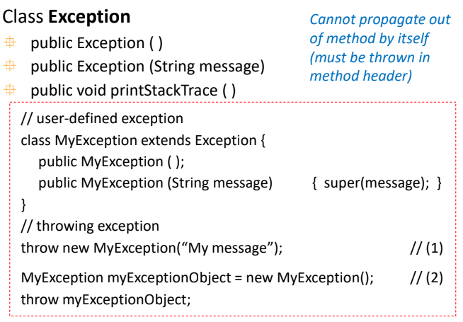
Checked Exception

Slide 23
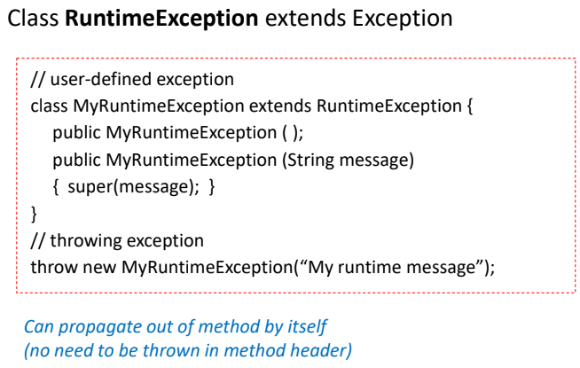
Unchecked Exception

Slide 24
Common Exceptions
Exception | Description
ArrayIndexOutOfBoundsException | Index is outside the bounds of an array
ArithmeticException | Illegal arithmetic operation (e.g., divide by zero)
NumberFormatException | String can't be converted to a number
IllegalArgumentException | Method receives an inappropriate argument
FileNotFoundException | File could not be found

Slide 25
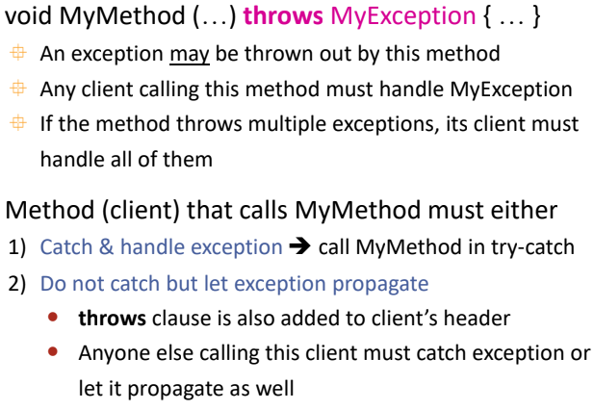
Method Throwing Exception

Slide 26
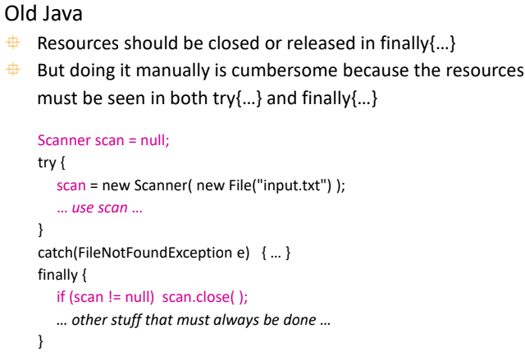
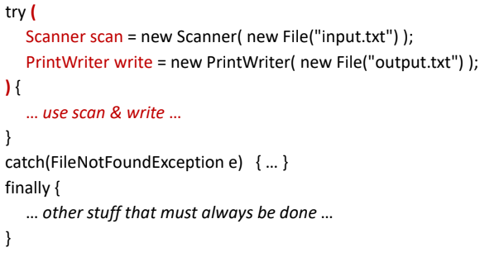
Try-with-resources
New Java

Slide 27
The End

Slide 28


